Slide 1
Files, Directories and Filesystems
Refer Chapters 35-40 of https://pages.cs.wisc.edu/~remzi/OSTEP/
For Ext2 see https://piazza.com/class_profile/get_resource/il71xfllx3l16f/inz4wsb2m0w2oz (up to page 9)
VFS internals references are given on the corresponding slides

Slide 2
Notion of Directories and files
Linux: Check out ls –R and similarly tree
/bin /home /proc
ls
who
ps
mount
cat
.
.
.
meminfo
cpus
2876
2667
.
.
manu
medha
first.c
a.out
proj1
main.c
main.h
main

Slide 3
The Filesystem abstraction – The user model
File is a often a sequence of data bytes.
The goal is to provide simple, seem-less access to the data in the file and information about the file.
Each filesystem provides a different model; and different efficiencies –
Navigation – flat vs hierarchical vs others ?
The information available (file meta information) ext3, xfs, FAT, NTFS
Creation/Access times, file size, directory structure, ownership & Access info, etc.
The kind of access – local vs over network – SMB/CIFS, NFS, WebDAV, Google-Drive, …
Models of identity and protection – local vs shared NIS, LDAP; Access Control Lists ; “owner-group-others” etc.
File access modes – sequential, random access, consistency models
In Unix/Linux – filesystems occupy a much more central role – they are a window to the internals of the system, devices,… (eg /proc /dev)

Slide 4
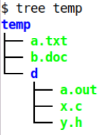
The Filesystem abstraction
User wants to store data, the FS provides access to the user for:
Data in the file
Information about the file
Organization/navigation of the files
Each filesystem provides a different model; and different efficiencies –
File access modes to data – sequential, random access
The information available (file meta information) ext3, xfs, FAT, NTFS
Creation/Access times, file size, directory structure, ownership & Access info, etc.
Navigation – flat vs hierarchical vs others ?
Ultimately the implementation depends on the media/storage device
The kind of access – local vs over network – SMB/CIFS, NFS, WebDAV, Google-Drive, …
Models of identity and protection – local vs shared NIS, LDAP; Access Control Lists ; “owner-group-others” etc.
In Unix/Linux – filesystems occupy a much more central role – they are a window to the internals of the system, devices (eg /proc, /dev)
Information about the file
0101011Bytes of a file0111101010001
Fragments on the device
Storage media/device

Slide 5
Permission and related metadata for a filesystem entry (ie a file or a directory)
Notion of owner and group
Every user has a userid and by default is the owner of any files/directies the user creates
Every user is in a group and has a groupid and by default that is the group of any files the user creates
Linux: See /etc/passwd and /etc/group
Permissions
Every file has permissions associated with the user/owner(u), users in the same group(g) and users other than those in the group(o).
Permissions say who has what permissions on the entry
Linux: See ls –l rw-rw-r--

Slide 6
A directory has a bunch of meta-information about each entity
Information/data – what is in the file – the data, eg a C program, executable, some text, an html, etc.
Meta-information – about the file – the file’s owner, size, timestamps, permissions
A directory is a special file that holds the meta-information of a set of files.
We says these other files are “in” or “under” that directory
The directory itself does not have any other information
Sometimes the directory is also called a folder.

Slide 7
Information about an entry (eg ext3)
See: stat(1) stat(2) fstat(2)
ls -li notes
1319854 -rw-r----- 1 prakash student 25 Aug 30 2022 notes
stat notes
File: notes
Size: 25 Blocks: 8 IO Block: 4096 regular file
Device: 805h/2053d Inode: 1319854 Links: 1
Access: (0664/-rw-rw-r--) Uid: ( 1000/ iiitb) Gid: ( 1000/ iiitb)
Access: 2023-07-21 15:08:24.238044227 +0530 atime (last time data was accessed… r )
Modify: 2022-08-30 17:22:56.384137466 +0530 mtime (last time data was modified… w)
Change: 2022-08-30 17:22:56.384137466 +0530 ctime (last time data or metadata¹ was updated)
Question: Where is this information stored?
¹ctime is not update when only a read of the file contents happens

Slide 8
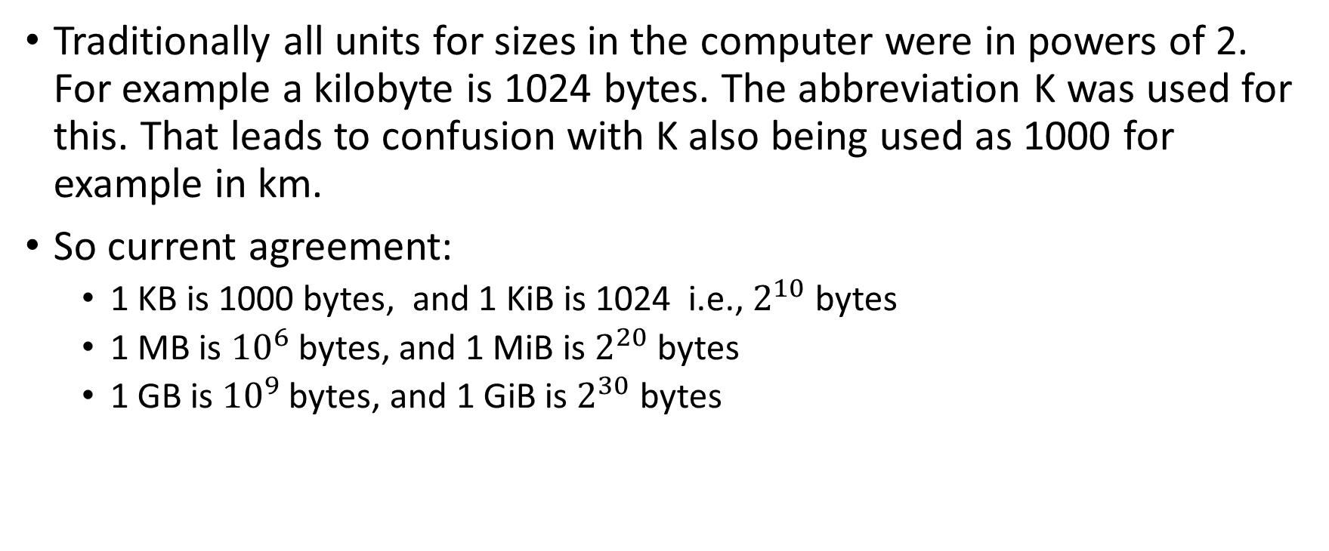
A small side note on units
Traditionally all units for sizes in the computer were in powers of 2. For example a kilobyte is 1024 bytes. The abbreviation K was used for this. That leads to confusion with K also being used as 1000 for example in km.
So current agreement:
1 KB is 1000 bytes, and 1 KiB is 1024 i.e., $2^{10}$ bytes
1 MB is ${10}^{6}$ bytes, and 1 MiB is $2^{20}$bytes
1 GB is ${10}^{9}$bytes, and 1 GiB is $2^{30}$ bytes

Slide 9
PART-1: On the Storage: Disks, Partitions & Filesystems
0
1
2
3
4
5
6
7
8
9
.
.
.
fs1
fs2
fs3
⩧
………… Logical Blocks ………..
………… Physical Sectors ………..

Slide 10
Disks and partitions to filesystems
Partition Table
Information about partitions on this block device
MBR
Partition 1
/dev/sdb1
Sequence of
Sectors (512bytes, 1Kbytes 4Kbytes)
Sequence of
Blocks (1K 4K
1M …)
/dev/sdb
DISK
Volume/ Partition boot sector
Partition 2
/dev/sdb2
scssi hard drive 1
fdisk
Partition 3
/dev/sdb3
DISK
PARTITION
FILESYSTEM
Partition Table along with boot information is stored in the first sector
of the block device. This is called the MBR (Master Boot Record)

Slide 11
From a partition to a filesystem How it becomes a directory
Example in UNIX/LINUX:
$ mkfs -t ext3 /dev/sdb1
$ mount –t ext3 /dev/sdb1 /tmp/mpt
$ cd /tmp/mpt
$ mkdir d1
$ vi d1/hello_world.c
..
..
..
Make a new filesystem on a device
Take a disk partition and organize its blocks and
create a directory structure.
Mount the device on the directory structure
Make the filesystem a part of the root directory tree (at a mountpoint)
Refer the directory for usual file operations
Now the FS is ready to use without reference to its device
DISK
PARTITION
FILESYSTEM

Slide 12
Try out filesystems exploration on a usb stick (use one you are ok to erase contents of)
Stick in the usb stick and see it discovered in /dev
Eg after it is inserted on one system /dev/sdb and /dev/sdb1 appeared
Make sure none of its partitions are mounted by default (so umount /dev/sdb1).
Make partition: sudo fdisk /dev/sdb
use p to see all the partitions
use d to delete an old partition and use n to create a new partition
create just one for experiment or as many as you wish
use w to commit the new partitions onto the disk
Explore partition and create a filesystem
On a new partition say: dumpe2fs /dev/sdb1 ( it should say there is no filesystem)
use mkfs to create a ext2 or ext3 or ext4 filesystem on /dev/sdb1 (notice the output of mkfs)
use dumpe2fs /dev/sdb1 to see details of the newly created filesystem
Mount the filesystem on an empty directory to use: mount /dev/sdb1 /tmp/mpt
See: fdisk(8) dump2fs(8)
Note: This is not covered in any standard text, so please refer the man pages, these slides and the video of the lectures.

Slide 13
Relating physical disks and OS devices and partitions
Name Major # Minor #
HBA
/dev/sda
0
8 1 8 2 8 3
8 16 8 17 8 18 ..
..
0
/dev/sda1
/dev/sda2
/dev/sda3
/dev/sdb
CPU
1
/dev/sdb1
/dev/sdb2
/dev/sdc
2
/dev/sdc1
Ref: Device Names and numbers

Slide 14
A look at the filesystem on data storage

Slide 15
Basic elements of common Linux filesystems
Data blocks: Indexed by block number
Indexed by inode number
Inode for one file
User data of a file/directory info is stored in a set of data blocks.
The information of which blocks these are is stored in an inode. (also meta information)
The set of inodes is stored in an inode table.
The list of free/used inodes is maintained in the inodes bitmap
The list of free/used blocks is maintained in a blocks bitmap
Inodes table
Inodes bitmap
Help identify free inodes/ data blocks
Blocks bitmap

Slide 16
Inside ext2 : Inodes….
Type and permissions information
Data containing Blocks
entry
Mode
Owner info (uid/gid)
Size, #links, ..
Timestamps (a,m,c)
Blocks
12 Block pointers
.
.
.
1 Indirect pointer
1 double indirect ptr
1 triple indirect ptr
Each file/directory is a sequence of blocks of data. The size of a block is set during mkfs. Eg 1 block=1024 bytes.
Inodes capture all file meta-info.
One inode per file/directory
Inode number is local to the filesystem.
Data blocks are just that; in the case of directories (see next)…
128
128
128
128
128
128
128

Slide 17
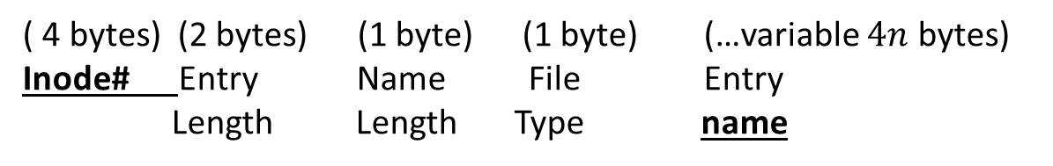
…. and an ext2 Directory’s data blocks
Fixed 8 bytes
( 4 bytes) (2 bytes) (1 byte) (1 byte) (…variable $4n$ bytes)
Inode# Entry Name File Entry Length Length Type name
Directories map file names to inode numbers.
(name padded with ‘zero’ bytes⓿ to be a multiple of 4 bytes)
143 12 1 2 . ⓿⓿⓿
176 12 2 2 . . ⓿⓿
2646 16 7 2 t e s t d i r⓿
1860 16 8 1 t e s t f i l e
.
.
.
.

Slide 18
Data blocks
This info is maintained in a set of blocks at the beginning
Inode table
Inodes bitmap
Blocks bitmap

Slide 19

Data blocks
This info is maintained in a set of blocks at the beginning of the filesystem
Inode table
Inodes bitmap
Blocks bitmap

Slide 20
Maintaining this information in ext2
The disk blocks of the filesystem are divided into groups
Each group has some blocks in the beginning that hold all this information
Inode table
Inodes bitmap
Blocks bitmap

Slide 21

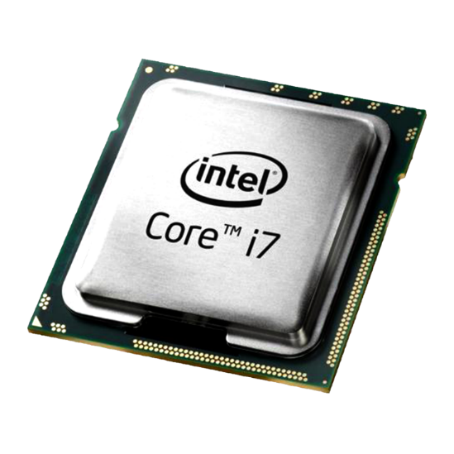
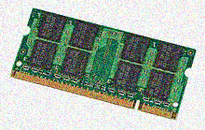
Ext2 blockgroups
Ext2 divides the blocks into block groups.
Each block group has this information in the first few blocks
For efficiency :
FS information is cached in RAM
VBR (partition specific boot sector)
DISK
filesystem
CPU
RAM

Slide 22
Block group information
The superblock and the GD(Group descriptor) list is the other information.
Note that this info is replicated in each block group.
GD : * # free inodes and blocks in the group. * block #s for the bitmaps and inode table.
GD Table
Data Blocks bitmap
SB
Inodes
bitmap
Inode table
GD1
GD2
GDn
Superblock
Magic # - filesystem identifier;
Group #
Block size ; First inode #; # blocks per group; etc.
For this group only
…

Slide 23
Reference
More details on ext2 here.
PARTITION
1
VBR
MBR
fs1
fs2
fs3

Slide 24
PART-2: Kernel operations and filesystems
USER
Kernel
fs1
fs2
fs3

Slide 25


Overview
Syscall API handler
VFS
including switching functionality
FD Table
OF Table
Inodes Table
NTFS
Ext2
CIFS
$……$
Device
Device Drivers

Slide 26
What happens when we open() a file
FILE * fopen() C library call in turn calls the open() system call.
FILE is a structure local to the process. Further it is a C abstraction.
open() returns an integer called a file descriptor (fd)
Each process has an fd table (local to the process).
The returned fd is an index to this table.
The fd #s are sequentially assigned to files open (eg open a file and print fd)
fd 0, 1, 2 are special (STDIN, STDOUT, STDERR)
The fd is a pointer to an entry in the open file descriptor table
0 - stdin
1 - stdout
fd table
of a
process
FILE *
int (fd)
2 - stderr
fopen
open
3 - file1

Slide 27
Using the fd – filesystem system calls
The fd can be used to do all operations on the file once opened
Common syscalls using an fd:
close() close(fd); // close the file read() read(fd, buf, n); // read n bytes into buf write() write(fd, buf, n); // write n bytes from buf lseek() lseek(fd, n, fromwhere); //move by n bytes fcntl() fcntl(fd, command, …); // a variety of commands dup() dup(oldfd); // make a copy of the fd dup2() dup2(oldfd,newfd); // make a copy, given the new fd mkdir() rmdir() link() unlink() … etc etc
We revisit some of these calls and concepts soon
See files/readfile.c

Slide 28
What happens when we open() – PART II
All calls to open create a new entry in the kernel’s global open files table. It is global because it is not process specific. Has this info:
What mode was it open
Read/Write position
A reference count
It also points to some version of the inode (got from the disk) (generic inode)
The process fd table entry points to this entry in the open files table.
The global generic inodes table of the kernel:
Is only one per file and has a lot of information about the files presence on the disk
It also has pointer to all the actual implementations of functions on the file (read(), write(), close(), etc)

Slide 29
Per process
File Descriptor table
Global, kernel data structures
Open Files table (struct file)
Generic Inode table (struct inode)
Sometimes referred to a vnodes
0 - stdin
Ref: Detailed inode info
1 - stdout
fd table for p1
2 - stderr
Open mode read/write pos ref count
Inode table entry….
3 - file1
4 - file2
All inode info Disk info .... file_operations ….
.
.
.
0 - stdin
1 - stdout
.
.
.
fd table for p2
2 - stderr
3 - file1
Ref: Detailed struct file info
4 - file4

Slide 30
Virtual File System Switch (VFS)
In OSes like Linux and UNIX what we described just now holds for:
Usual file systems over different kinds of file systems – NTFS, ext2,xfs, ramfs, network filesystems, etc
For special filesystems, files and directories (eg entries in /proc )
This is enabled by having in the in-RAM inode table a pointer to different FS specific function implementations
This allows much of the kernel infrastructure to be reused in a generic, filesystem independent fashion.
The term ‘switch’ in the name indicates it helps to switch to the appropriate functionality depending on the filesystem

Slide 31
VFS and the other components
Use Space Code
User mode
Syscall API handler
syscall Table
Kernel mode
VFS
including switching functionality
sys_read()
FD Table
OF Table
Inodes Table
ext2_read()
NTFS
Ext2
CIFS
$……$
Device
Device Drivers

Slide 32
System call interface to the filesystem

Slide 33
FS Calls in Linux
File descriptor table (fd, process specific)
File table (offset, mode, permission, pointer to inode table)
Inode Table (inode number, pointer to Data Block).
With pointer to fs specific functions
Data Block (where a file is stored)
RECALL
Library Functions (Application Programs)
printf(3),scanf(3),fopen(3), fwrite(3), fread(3), fclose(3)
(VFS) System Calls
open(2), write(2), read(2), close(2) … all these do syscall with the syscall number
Correspoding entry points in kernel sys_read , sys_write, etc.
FS specific entry Points
ext2_write, ext2_read, ext2_close…

Slide 34
read(fd, &buff, sizeof(buf))
creat / open
read, write
lseek
close, unlink
dup / dup2
fcntl
stat
select
sync
Return to caller - 10
Library procedure
read
Trap to the kernel - 6
Put code for read in register
5
Increment stack pointer -11
User Space
User program calling read
Call read - 4
Push fd - 3
Push &buf - 2
Push sizeof(buf) -1
9
7
Dispatch
System call
handler
Kernel Space
8
System Call vector table

Slide 35
FS Calls to open, create, read and write
int creat (char *file_name, mode_t mode)
int open(char *file_name, int flags);
int open (char *file_name, int flags,mode_t mode);
Ex: fd = open(“temp”, O_WRONLY|O_APPEND, 0644);
int write ( int fd, const void *buf, int count);
it writes count bytes to the file from the buf.
On success return with: Number of bytes written
0 - indicates nothing was written or -1 on error.
int read ( int fd, void *buf, int count);
It reads count bytes from the file and store the data into the buf.
On success return with: Number of bytes read
0 - indicates end of the file or -1 on error.

Slide 36
.. More examples
Moving the read / write pointer of the file
int lseek (int fd, long int offset, int whence);
whence: SEEK_SET, SEEK_CUR or SEEK_END – from the end of file
On success the system call returns with any one of the following value:
Offset value or 0 or -1
Duplicating the fd table entry
int new_fd = dup (old_fd);
int dup2 (int new_fd, int old_fd);
dup or dup2 duplicate the oldfd into the newfd.
new_fd and old_fd share Open File Table entry including locks, file position and flags.
NB: For dup2() if the newfd given is already being used, then that file is closed.

Slide 37
… More examples
int stat (“file_name”, struct stat *);
int fstat (fd, struct stat *);
int lstat (“file_name”, struct stat *);
These system calls read and return inode information; like what is see when we use stat(1).
See check-fileinfo.c

Slide 38
System Calls (3/3)
IGNORE
Select is a system call used to handle more than one file descriptor in an efficient manner.
int select (int n, fd_set *readfds, fd_set *writefds, fd_set *exceptfds, struct timeval *timeout);
fd_set is the file descriptor set, which is an arrays of file descriptors.
FD_CLR (int fd, fd_set *myset); FD_ISSET (int fd, fd_set *myset);
FD_SET (int fd, fd_set *myset); FD_ZERO (fd_set *myset);

Slide 39
… more examples
void sync () Write cached changes to the disk
int close (fd) Close an fd
int link(oldpath, newpath) Create a hard link
int unlink(file_name) Equivalent to $rm file_name
link() and unlink() increment and decrement the ref count of the inode of the file.
When an unlink causes the ref count in the inode to go to zero then the inode and corresponding file blocks on the filesystem are freed up.

Slide 40
… more examples
void sync () Write cached changes to the disk
int close (fd) Close an fd
int link(oldpath, newpath) Create a hard link
int unlink(file_name) Equivalent to $rm file_name
IGNORE
Linux uses internal routines for accessing a file. For example
namei() (convert a “file_name” into an inode)
iget() (reads an I-node)
iput() (writes an I-node)
bread() (read a block from buffer cache/disk)
bwrite() (write a block from buffer cache to disk)
getblk() (get a free block in the buffer cache)

Slide 41
A word about links
Experiment $ ls -i notes 6989 notes
$ ln -s notes notes-s
$ ln notes notes-h
$ ls -i notes* 6989 notes 6989 notes-h 9854 notes-s
$ stat notes-s .... $ stat notes-h ….
Two types of link entries are possible
Softlink (symbolic link) – is just a string associated with an entry.
It is a useful way to refer to a file located elsewhere.
The referred entry need not exist
Has its own inode
Hardlink (link) –
The entry has the inode number of the destination
Like another name for the same inode
It increments inode refcount
Removing a softlink just removes a directory entry and has nothing to do with the referred path.
Removing a hardlink can delete the file (unlink) if the refcount goes to zero
Only hardlinks increment inode refcount.

Slide 42
Filesystems and concurrent access control
Since files can be open simultaneously by multiple processes it can lead to inconsistency in file usage.
Typical problem with concurrent access. Files is just one example. We will see this again in other places in the os and in thread / process concurrency in general.
A common way to deal with this to have processes cooperating (following some agreed access strategy, using specific support from the OS)
This is called Advisory locking – eg check: flock() and fcntl() in linux.
Another way is to use Mandatory locking (locking enforced by the OS)
Not very well supported in Linux – eg check fcntl(), O_EXCL in open()
A simple example in Linux (flocking.c)

Slide 43
Interesting uses of file descriptors beyond reading files

Slide 44
Example 1
0
1
2
3
0
---
2
3
0
1
2
Newfd = dup(1)
Close(1)
Though 1 is closed, we can still write to the screen using 3
OFT
See usingdup.c

Slide 45
Example 2
0
1
2
3
0
1
2
3
0
1
2
Newfd = open(somefile…)
Dup2(3,1)
Now writing to 1, writes into a file (not STDOUT). This is output redirection!
Exercise: Can you modify your shell to support output redirection?
OFT
See redirect.c

Slide 46
Pipes – nothing but a pair of FDs one for reading and another for writing.
p[0] is a read fd
p[1] is a write fd
int p[2];
pipe(p); a linux syscall to create a pipe
write(p[1],……..)
pdfA[0]
read(p[0],…...)
pdfA[1]
Each end has a corresponding fd, however ….
…. there is no real file on the disk
Why would this be useful at all?

Slide 47
fork() exec() and filedescriptors
exec() inherits all file descriptors of the process
fork() duplicates all file descriptors of the parent to the child process
Thus after a fork and an exec the original file descriptors remain accessible, and to both processes in case of fork()
fork() increases the reference count in the OFT

Slide 48
Example 3 Piping data between processes
parent
Read p[0]
Write p[1]
dup2(p[0],0)
All scanf()s and read(0, ..) will read from the pipe
pdfA[1]
pdfA[0]
fork()
Child
Write p[1]
Read p[0]
dup2(p[1],1)
All printf() and write(1, ..) will write to the pipe
Note: This is true even if you exec after the dup2()! Task: Can you add pipining facility to your shell?
See pipecmd.c

Slide 49
The C Language and buffered IO
The C library does IO (fprintf/fscanf/fread/fwrite) buffered by default in the user space. This has a couple of effects:
Benefit: (a) reduce # IO, (b) reduce # syscalls – both take time.
Curious behavior:
Sometime the stuff that you print may not appear as soon as you print
The parent and child get a copy of this user space buffer when you fork() after a printf.
See flush.c
You can force flushing of an output buffer using flush(3).
The buffer is often called a line buffer because ‘\n’ in the output string causes the output buffer to be flushed to the device.
You can change the flushing behavior using setbuf(3).
GNU C does the following: https://www.gnu.org/software/libc/manual/html_node/Flushing-Buffers.html

Slide 50
Efficiency Considerations

Slide 51
The cost of reading and writing to a filesystem
Consider: open(“/a/b”) on the disk:
“/” (d) read “/”s inode for permissions ; search for “a” in its data, retrieve its inode number
“a” (d) read “a”s inode for permissions ; search for “b” in its data, retrieve its inode number
“b” (f) read b’s inode make sure the user has the right permissions to open it.
Need to update inode (access times) for each of the items on the path.
In the case of read(fd), we already have the fd pointing (through the open file table) to the inode for “b”.
Then we read the inode to find the data blocks.
Then we read the data blocks to retrieve the data.
Lastly update inode (access time) for the inode for “b”
Clearly write(“b”) is even more costly

Slide 52
Efficiency requirement
Disks are much slower than the CPU.
We need to do something to keep the access times to blocks low.
This includes all blocks:
Superblocks
Inodes
Free bitmaps for both data and inodes

Slide 53
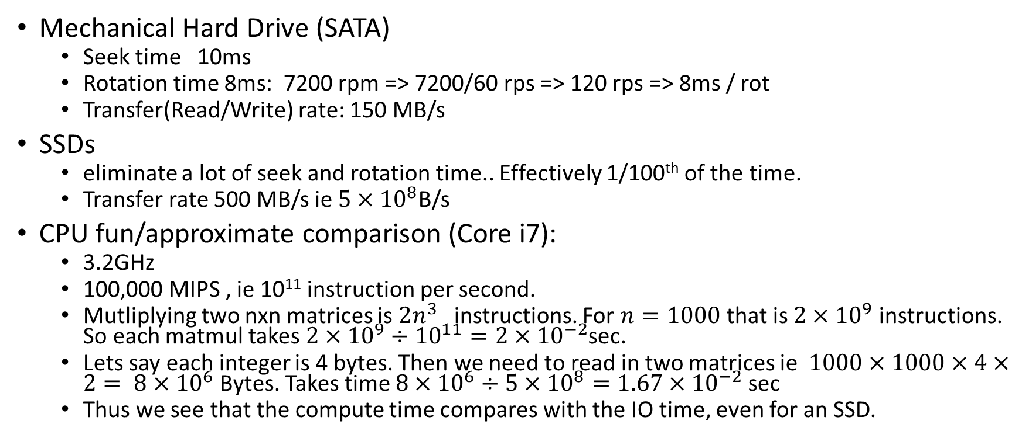
A look at the times involved in reading from a hard drive
Mechanical Hard Drive (SATA)
Seek time 10ms
Rotation time 8ms: 7200 rpm => 7200/60 rps => 120 rps => 8ms / rot
Transfer(Read/Write) rate: 150 MB/s
SSDs
eliminate a lot of seek and rotation time.. Effectively 1/100th of the time.
Transfer rate 500 MB/s ie $5×{10}^{8}$B/s
CPU fun/approximate comparison (Core i7):
3.2GHz
100,000 MIPS , ie 10¹¹ instruction per second.
Mutliplying two nxn matrices is $2n^{3}$ instructions. For $n=1000$that is $2×{10}^{9}$ instructions. So each matmul takes $2×{10}^{9}÷{10}^{11}=2×{10}^{−2}$sec.
Lets say each integer is 4 bytes. Then we need to read in two matrices ie $1000×1000×4×2= 8×{10}^{6}$Bytes. Takes time $8×{10}^{6}÷5×{10}^{8}=1.67×{10}^{−2}$sec
Thus we see that the compute time compares with the IO time, even for an SSD.

Slide 54
Disk Characteristic times/ rates
Every block number is mapped to a specific sector on a specific track
Circular track with several 512 Byte sectors of data in each track
Head
Head Movement Path
This is a simple schematic for a mechanical hard disk
In reality we may have multiple such disks ‘stacked’ to create a cylinder and each with its own read/write head.
The read/Write head moves in a straight line from track
Track to track ( Seek latency is the time for the head to get to the appropriate path)
Once on the track the head waits for the appropriate sector to come under it (rotational latency)

Slide 55
(1) Caching or I/O Buffering in the filesystem
Caching: Keep “popular” info from the disk in the RAM.
Tradeoff – spending some memory but improve disk access speed
What is popular changes over time and without notice
LRU may be a good way to decide which blocks to evict from the cache when needed.
I/O Buffering: Don’t write data onto blocks each time. Be lazy about it.
Multiple writes get grouped together into one write to the disk.
Written stuff can be modified easily without too many IO
Note that this means what is written may not go to the disk immediately.
sync() as an API to deal with this.
A Temporary file never needs to be on the disk!
The notion of dirty blocks and reclaiming

Slide 56
(2) Dentry lookup (Dentry = a single directory entry)
In most filesystems everything is an inode.
Traversing the file tree hierarchy is common way to map a path to a file , eg /home/iiitb/courses = “/” “home” “iiitb” “courses
The lookup consists of following several directory entries … thus several disk operations
That can get complicated further by mounting which is very common
Therefore there is support for hierarchical filename lookup – dentry
This is a pure in memory structure built from inodes and mount point information, supported by hashing for quick lookup.
Ref: See the figure in https://myaut.github.io/dtrace-stap-book/kernel/fs.html

Slide 57
(3) Block groups and locality on the disk
We studied this earlier
Disk scheduling for sector reads
Most assume some kind of moving “head”
Some algorithms.. Among others:
FCFS etc
SCAN and C SCAN

Slide 58
(4) Resistance to crashes - Journaling
Crashes lead to the filesystem not being updated consistently.
One reason for fsck
Additional “Journal” area on the filesystem to record all the intended updates
Used to recreate the filesystem in the case of a crash
One of the enhancements to ext3 from ext2 is support for journaling.

Slide 59
Device Drivers
A device (hardware) usually exposes an interface requiring a protocol for achieving the operation
A hardware interface could be
A data register
A command register
A status register
A protocol (for a write operation) could be
Test status if ready
Once ready write data to the data register
Put the command (eg ‘write’) on the command register
Read status to ensure the command has been completed

Slide 60
Role of interrupts and DMA
Interrupt mechanism ensure OS doesn’t have to wait on the status.
DMA is a hardware support to ensure that the CPU does not have to spend time to write data to / read data between device and memory.
Programmed IO vs DMA
CPU
DMAC
RAM
DISK

Slide 61
Device Drivers and Buffering for a different reason!
At the lowest level we need some software that talks with the hardware of a device – Device Driver
The driver needs to communicate with the device on one side and the rest of the OS on the other side.
The two have different speeds and different ways of working.
One problem is that of data transfer between device and OS arising from their different speeds
Kernel handlers
Write buffer
Read buffer
Write buffer
..
..
wait
wait
DD
Double buffering
Extendable to a buffer ring

Slide 62
More Optimizations ON the Disk
Striping
Redundancy
Parity
RAID-0 or pure striping data blocks over m disks
RAID-1 or duplication/redundancy of data blocks over 2 disks
The above may be combined
RAID-10 stripe data blocks over m disks, further replicated on m other disks
Other strategies – based on parity
RAID-5 m blocks striped over m+1 disks with the next one acting as parity
Other configurations are possible
See: https://en.wikipedia.org/wiki/Standard_RAID_levels for example

Slide 63
Some file types
See the first character in ls –l
Some typical file types
Files
Directories
Devices (block & character devices)
Soft link
Links
Hard links – multiple directory entries pointing to the same inode
Softlinks – a string associated with a filename often the string is a path to another file or directory, but in reality can be anything, eg a non-existing file

Slide 64
Summary
We understood disk-partition-filesystem
We know how to create filesystems on partitions.
We saw important kernel tables FD table, OF table, Inode Table
We saw the notion of VFS on Unix/Linux type systems
We saw a number of file / descriptor related system calls
In particular we saw the use of dup and pipe to create interesting applications. We also saw how flock works.
We saw efficiency is an important consideration for filesystems.
Please study and play with the code examples in files/

Slide 65
Ends the chapter on filesystems

